Slide 1

BEAUTY BOOKING
Mariam CHARRADA #C21

Slide 2
OUTLINE
Context
Challenges
Core Algorithms
Team
Technologies & Architecture
Process & Timeline

Slide 3
01
Context
The story behind
BEAUTY BOOKING
Notes:
Why isnt booking a beauty service not as EZ as ordering a pizza?
What if there was an app… like a beauty superhero for bad hair days??

Slide 4
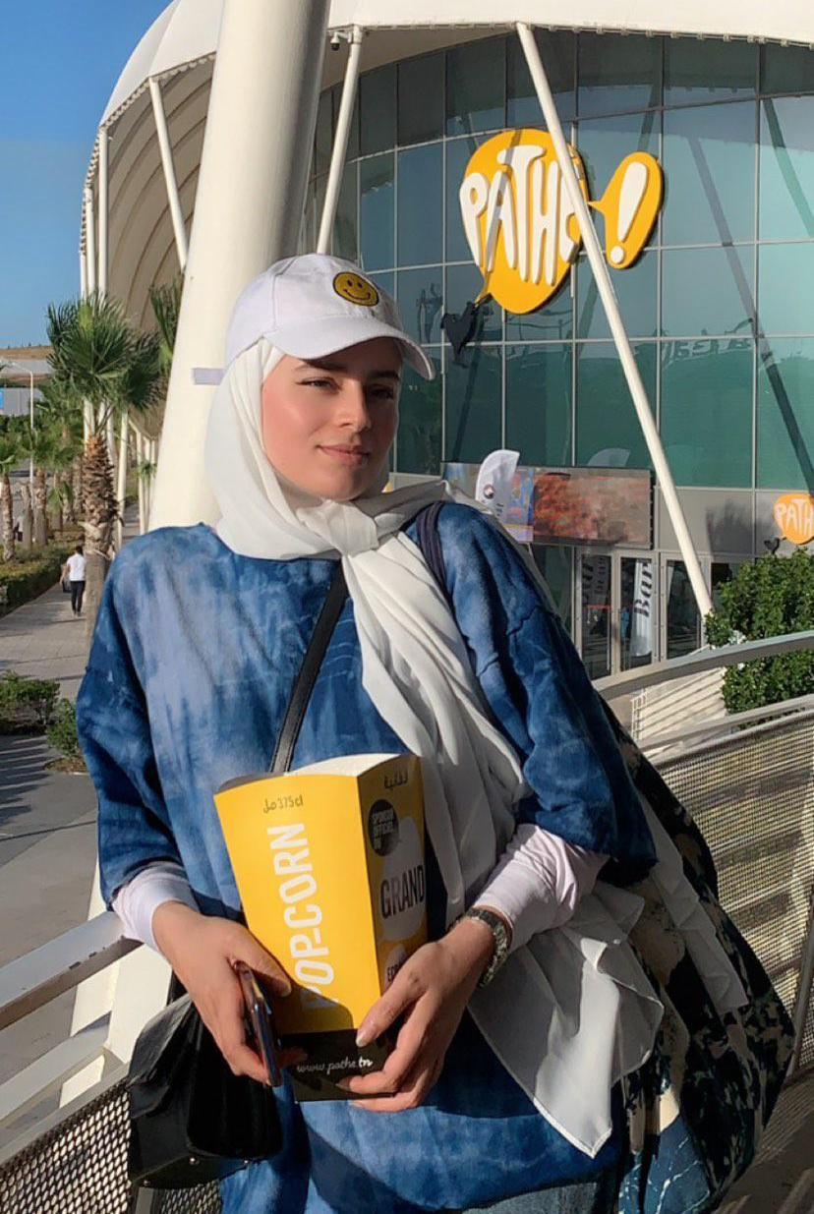
TEAM
Project Manager
Developer
Designer
Tester
Popcorn Lover
Notes:
#MyOwnBoss
#SoloMission but Def not an easy one!

Slide 5
CHALLENGES
- Understanding new frameworks
- Time management
- Endless errors!
Notes:
=> prioritize some tasks and overlook some others

Slide 6




TECHNOLOGIES
Mongo DB
Node js
Express js
React Native(Expo)
Database
Running Environment
(backend)
Backend framework
Frontend framework

Slide 7
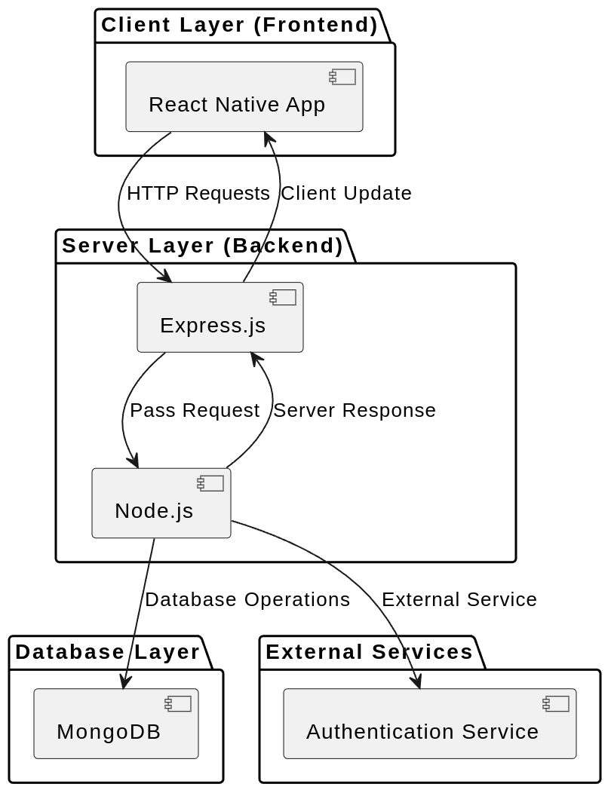
ARCHITECTURE
Client Layer
Server Layer
Database Layer

Slide 8
CORE ALGORITHMS
Authentication & Password Hashing
Registration
Appointment Booking

Slide 9
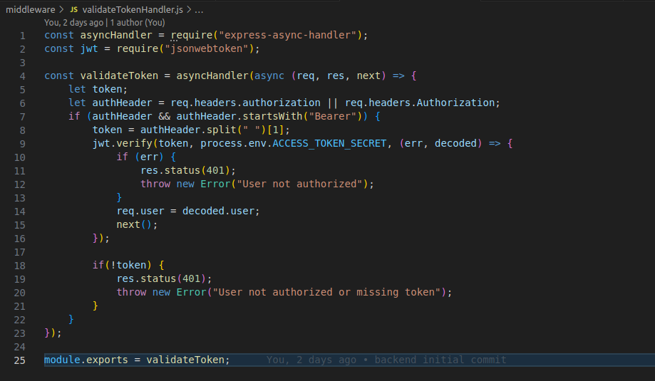
Authentication & Password Hashing

Slide 10
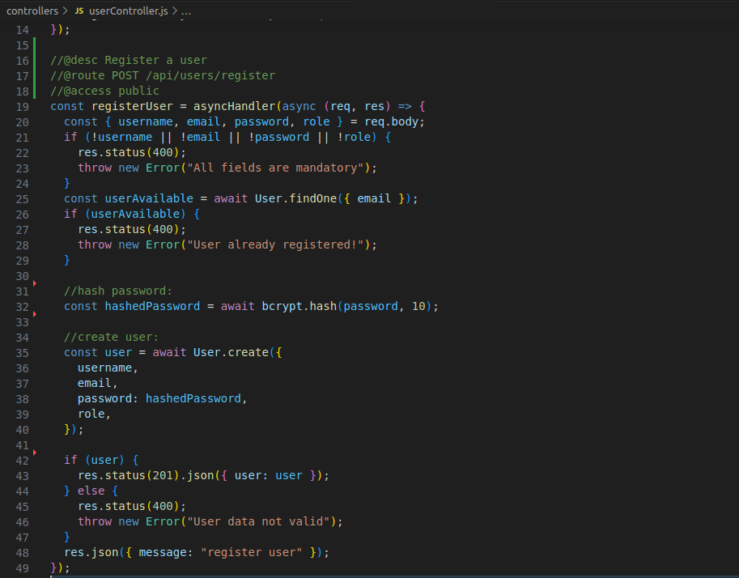
Authentication & Password Hashing

Slide 11
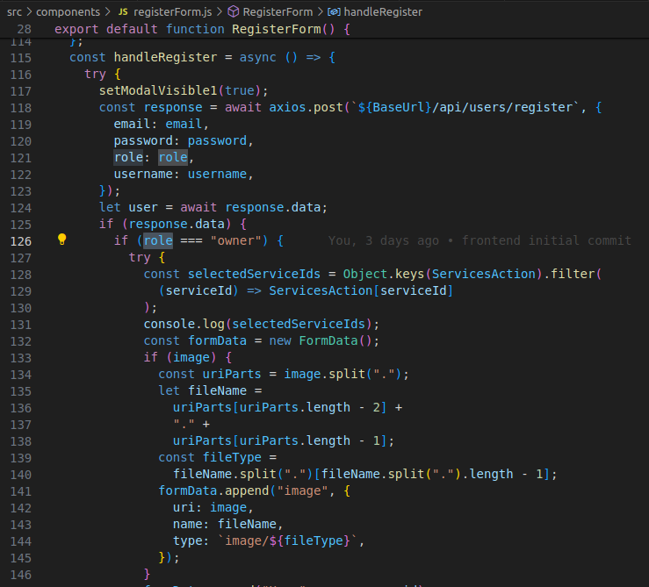
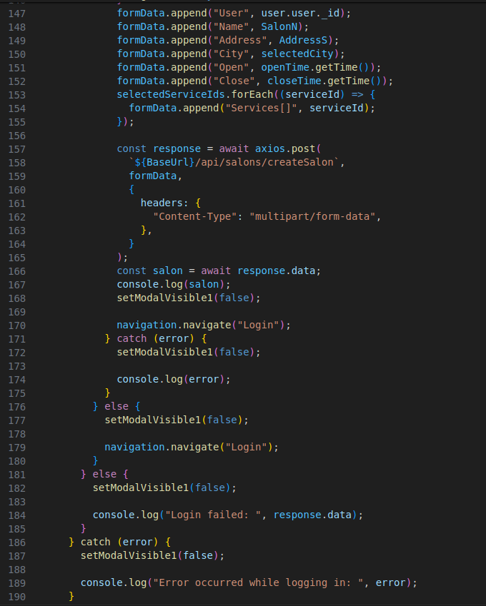
Double Registration

Slide 12
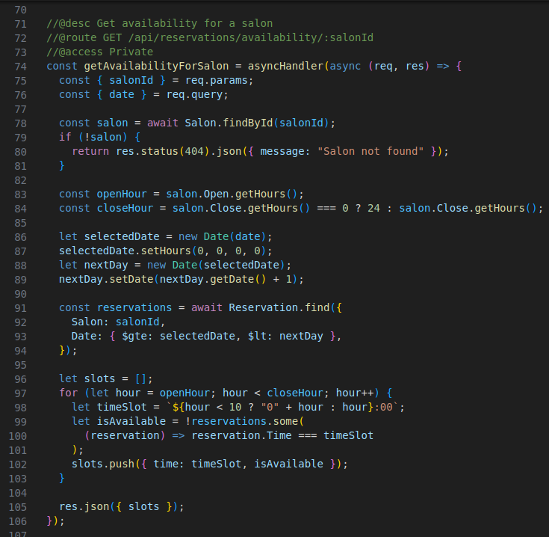
Appointment Booking (Node js)

Slide 13
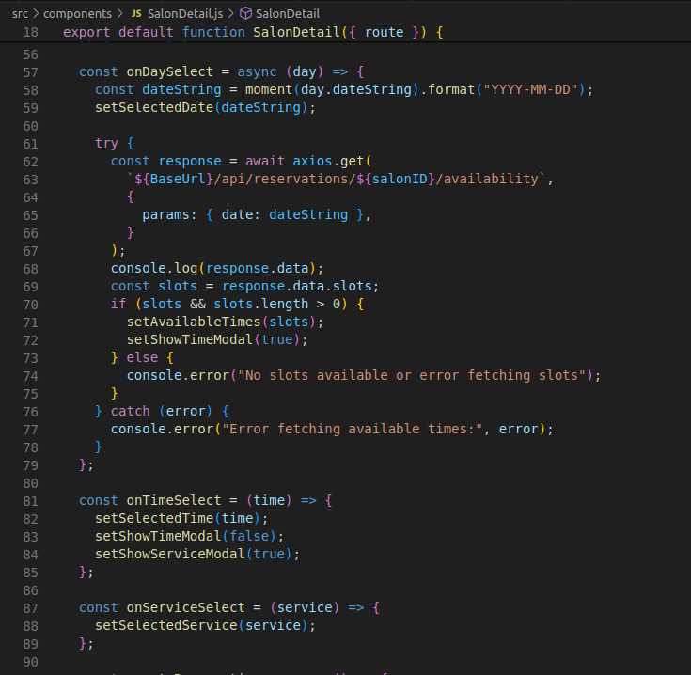
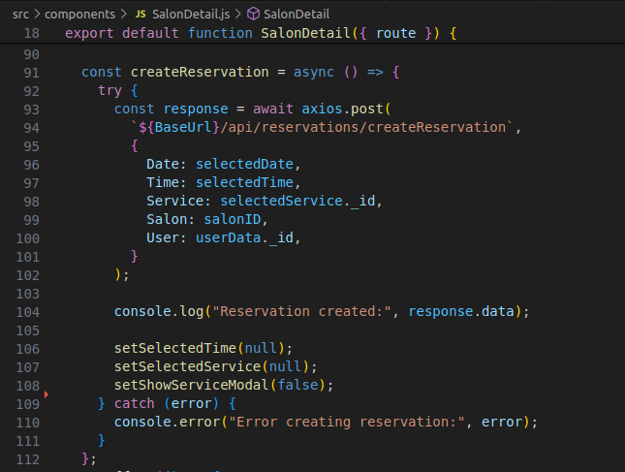
Appointment Booking (RN)

Slide 14


PROCESS & TIMELINE
WEEK 1+2
WEEK 3+4
WEEK 4-6
Learning
Api integration
+
Test & validation
Express
+
Api testing
+
RN Screens

Slide 15
THANKS!
info@slidesgo.com
+91 620 421 838
yourcompany.com
Do you have any questions?
Please keep this slide for attribution

